Slide 1

School of Physics
‘$Search for dark matter in the MonoHiggs to b\overline{b}+p_{T}^{miss} final state$’

Slide 2
Outline

Slide 3

Outline
Signal and background
Major backgrounds
Event Selections and Object Selections
Signal Region
Control Region
The Top $μ$ resolved CR
Future plan
References

Slide 4
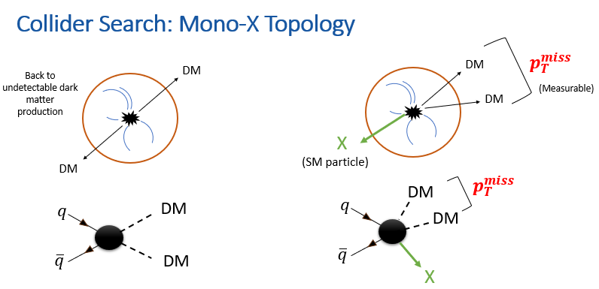
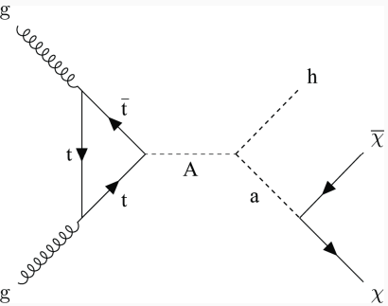

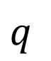

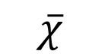
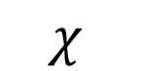
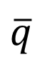
$p_{T}^{miss}$
$$χ$$
$$q$$
$$\overline{χ}$$
$$\overline{q}$$
h
Mono Higgs Searches
No Initial State Radiation
More closely connected to DM production
Signal Signature has a high MET trail which helps to separate the signal from background.
H(125)->bb branching ratio is ~ 57%
The 2HDMa Model
My focus H(125)->bb
Final state: $H(\overline{b}b)+p_{T}^{miss}$
Recap

Slide 5
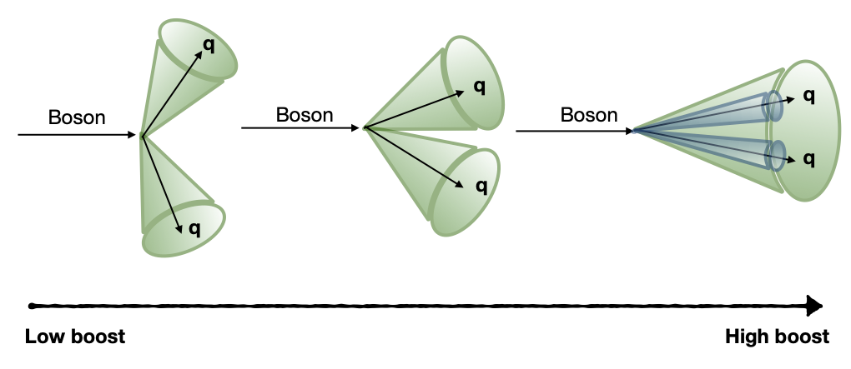
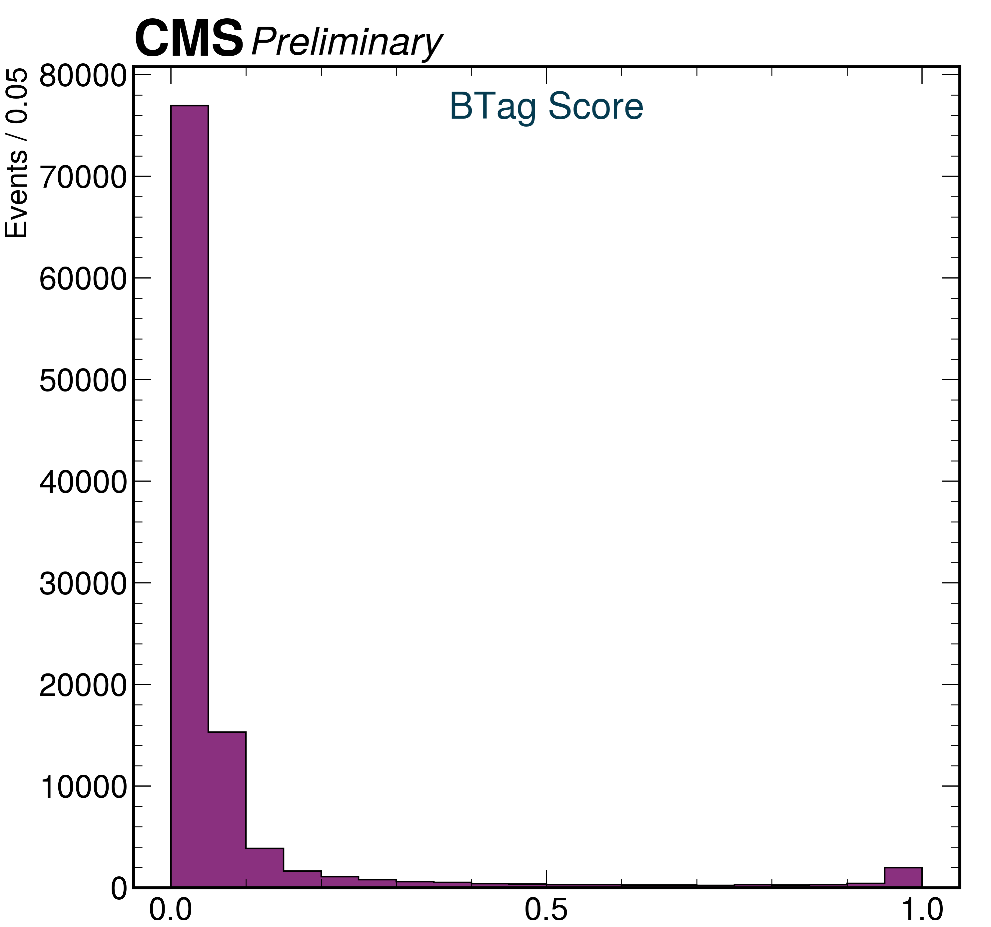
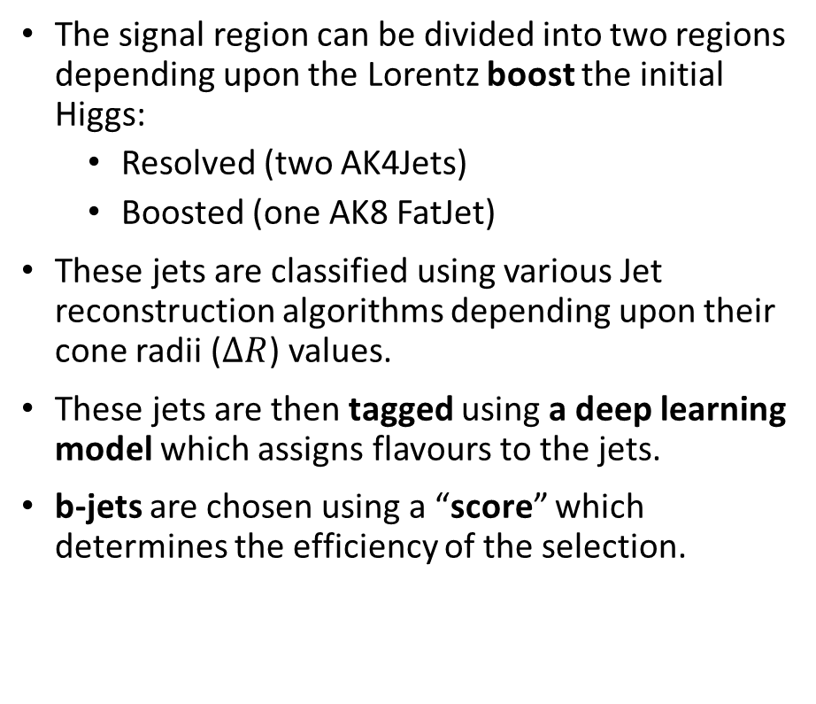
Signal and Background
Resolved
Boosted
The signal region can be divided into two regions depending upon the Lorentz boost the initial Higgs:
Resolved (two AK4Jets)
Boosted (one AK8 FatJet)
These jets are classified using various Jet reconstruction algorithms depending upon their cone radii ($ΔR$) values.
These jets are then tagged using a deep learning model which assigns flavours to the jets.
b-jets are chosen using a “score” which determines the efficiency of the selection.
2018 DATA
1 Million events processed

Slide 6
Signal and Background
The backgrounds which mimic the dijet and missing transverse energy signal are :
Z(νν)+jets
W+jets
Drell-Yan(DY)+jets
Top quark pair production (tt)
Single top production(ST)
The production of the single top quark association with W boson (tW)
Diboson (WW, WZ, ZZ)
The associated production of a Higgs Boson with vector bosons (WH and ZH)
These backgrounds are estimated by using samples generated by Monte Carlo simulation of the reactions.
In addition to background, the 2HDMa(or closely related ZprimeBaryonic) model is also available as a simulated sample.

Slide 7
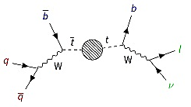
Major Backgrounds: top Control Region
The top-top is the major background to the final state.
This background is estimated by defining a ‘Control Region’ which is designed to tag such a background.
Diagram: https://www.phys.ksu.edu/reu/archive/2022/mclennan.html

Slide 8
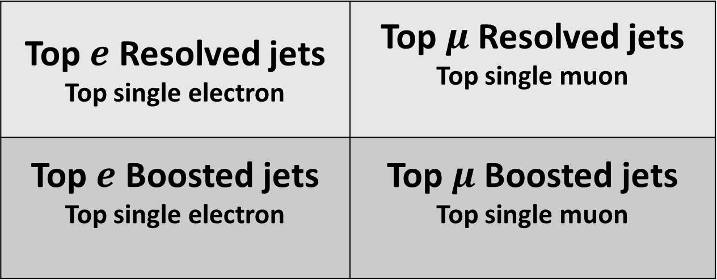
Major Backgrounds: top Control Region
This control is called the Top Control region and is further subdivided into four categories.
Top $e$ Resolved jets Top single electron | Top $μ$ Resolved jets Top single muon
Top $e$ Boosted jets Top single electron | Top $μ$ Boosted jets Top single muon
Jet angular separation
Lepton variety
Notes:
Questions:
Why is there no tau CR?
Check in the 2016 paper

Slide 9
Event Selections and Object Selections
Various selections are applied to select the most well-suited events from other events or detector noise. These selections are known as event selections.
Objects are the basic analytic units such as particles or jets of particles. Various object selections are applied to choose the best object candidate with a known level of confidence and efficiency. These selections are known as object selections.

Slide 10
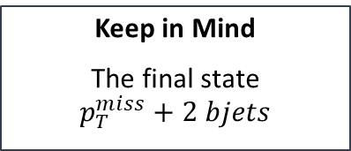
Selections in Signal Region and Control Region
Orthogonality
Allow no leptons in SR.
Force one or two leptons in CR.
Keep in Mind
The final state
$$p_{T}^{miss}+2 bjets$$
The Basic Philosophy
Keep SR selections and CR selections similar but orthogonal to each other.

Slide 11
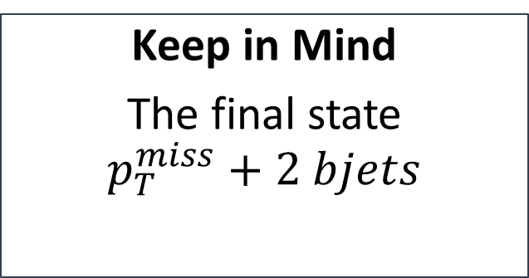
Selections in Signal Region and Control Region
Orthogonality
Allow no leptons in SR.
Force one or two leptons in CR.
The Basic Philosophy
Keep SR selections and CR selections similar but orthogonal to each other.
Keep in Mind
The final state
$$p_{T}^{miss}+2 bjets$$

Slide 12

Selections in Signal Region and Control Region
The Basic Philosophy
Keep SR selections and CR selections similar but orthogonal to each other.
Keep in Mind
The final state
$$p_{T}^{miss}+2 bjets$$
Orthogonality
Allow no leptons in SR.
Force one or two leptons in CR.

Slide 13
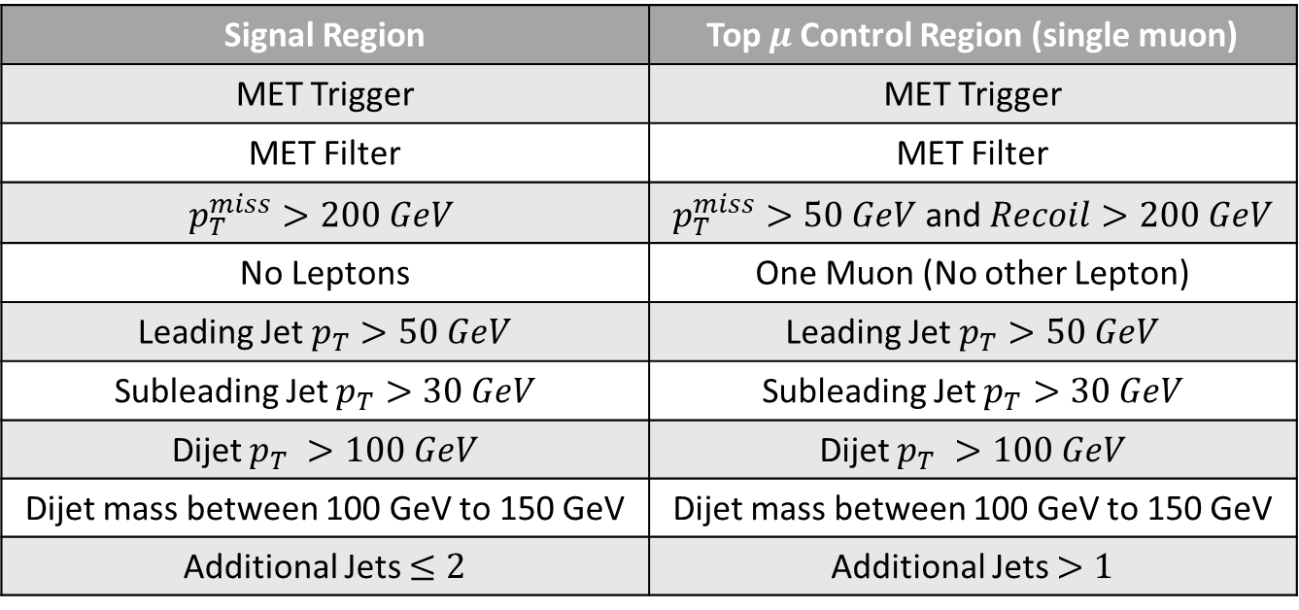
Selections in Signal Region and Control Region
Resolved
Signal Region | Top $μ$Control Region (single muon)
MET Trigger | MET Trigger
MET Filter | MET Filter
$$p_{T}^{miss}>200 GeV$$ | $p_{T}^{miss}>50 GeV$ and $Recoil>200 GeV$
No Leptons | One Muon (No other Lepton)
Leading Jet $p_{T}>50 GeV$ | Leading Jet $p_{T}>50 GeV$
Subleading Jet $p_{T}>30 GeV$ | Subleading Jet $p_{T}>30 GeV$
Dijet $p_{T} >100 GeV$ | Dijet $p_{T} >100 GeV$
Dijet mass between 100 GeV to 150 GeV | Dijet mass between 100 GeV to 150 GeV
Additional Jets $≤2$ | Additional Jets $>1$

Slide 14
Selections in Signal Region and Control Region
Resolved
Signal Region | Top $μ$Control Region (single muon)
MET Trigger | MET Trigger
MET Filter | MET Filter
$$p_{T}^{miss}>200 GeV$$ | $p_{T}^{miss}>50 GeV$ and $Recoil>200 GeV$
No Leptons | One Muon (No other Lepton)
Leading Jet $p_{T}>50 GeV$ | Leading Jet $p_{T}>50 GeV$
Subleading Jet $p_{T}>30 GeV$ | Subleading Jet $p_{T}>30 GeV$
Dijet $p_{T} >100 GeV$ | Dijet $p_{T} >100 GeV$
Dijet mass between 100 GeV to 150 GeV | Dijet mass between 100 GeV to 150 GeV
Additional Jets $≤2$ | Additional Jets $>1$
Same
Same
Different
Different
Same
Same
Same
Same
Different

Slide 15
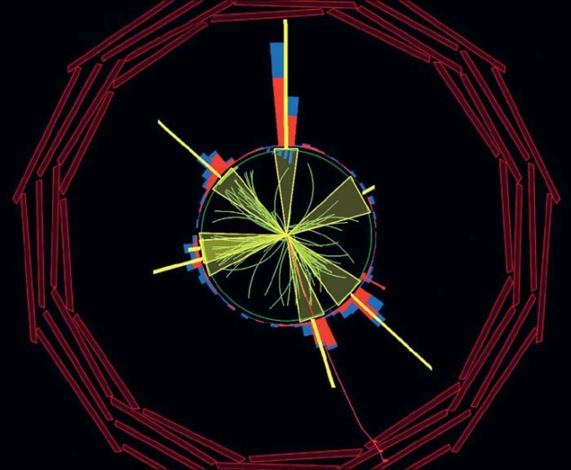
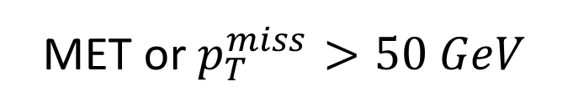
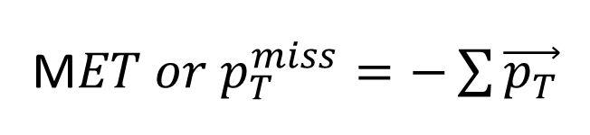
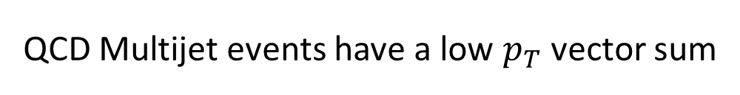
MET and Recoil criteria
MET cuts to avoid QCD
Recoil
M$ET or p_{T}^{miss}=−\sum{\vec{p_{T}}}$
MET or $p_{T}^{miss}>50 GeV$
https://cerncourier.com/a/a-watershed-the-emergence-of-qcd/
This cut ensures that we remove the majority of QCD events
QCD Multijet events have a low $p_{T}$ vector sum

Slide 16
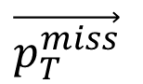
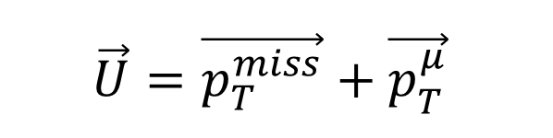
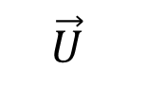
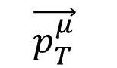
MET and Recoil criteria
bjet
bjet
MET cuts to avoid QCD
Recoil
$$\vec{U}=\vec{p_{T}^{miss}}+\vec{p_{T}^{μ}}$$
$$\vec{p_{T}^{μ}}$$
To mimic the effect of MET in the signal region, we define recoil which is the 2D vector sum of MET and transverse momentum of the chosen muon.
$$\vec{p_{T}^{miss}}$$
$$\vec{U}$$

Slide 17
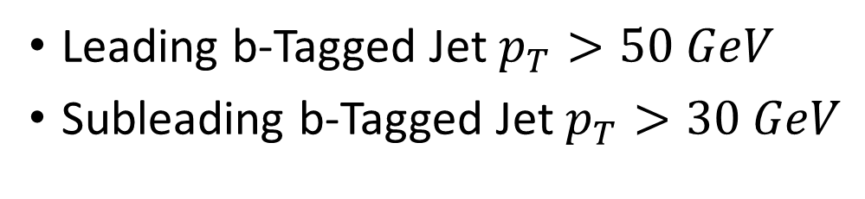
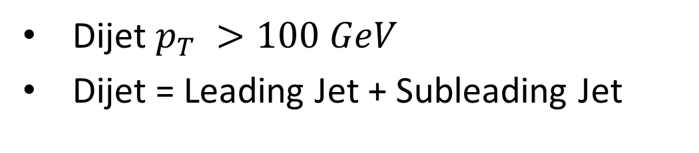
$p_{T}$ criteria and mass criteria
Leading b-Tagged Jet $p_{T}>50 GeV$
Subleading b-Tagged Jet $p_{T}>30 GeV$
To ensure a balanced contribution from both the jets (greater angle between Higgs line of travel and b jets)
Dijet $p_{T} >100 GeV$
Dijet = Leading Jet + Subleading Jet
To get a better probability that the dijet originates from a Higgs candidate with mass ~ 125 GeV
Dijet mass between 100 GeV to 150 GeV

Slide 18













My Efforts
Extensively used the COFFEA (Columnar Object Framework For Effective Analysis) Framework along with various other Python data analysis packages such as Dask, NumPy, SciPy, etc.
Preliminary development done locally in a server in lab, after which scaled to high throughput compute farms in University of Wisconsin, Madison, USA.

Slide 19
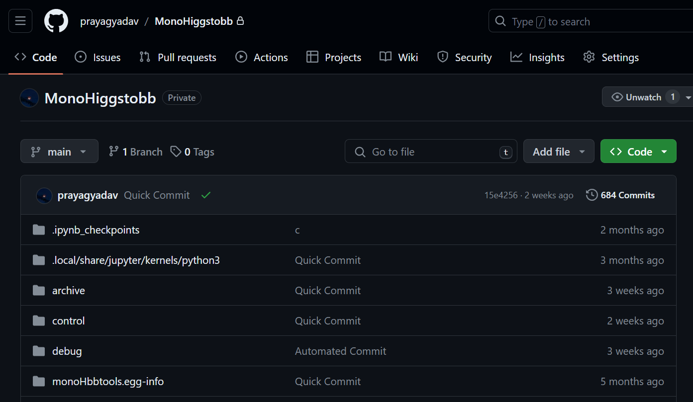
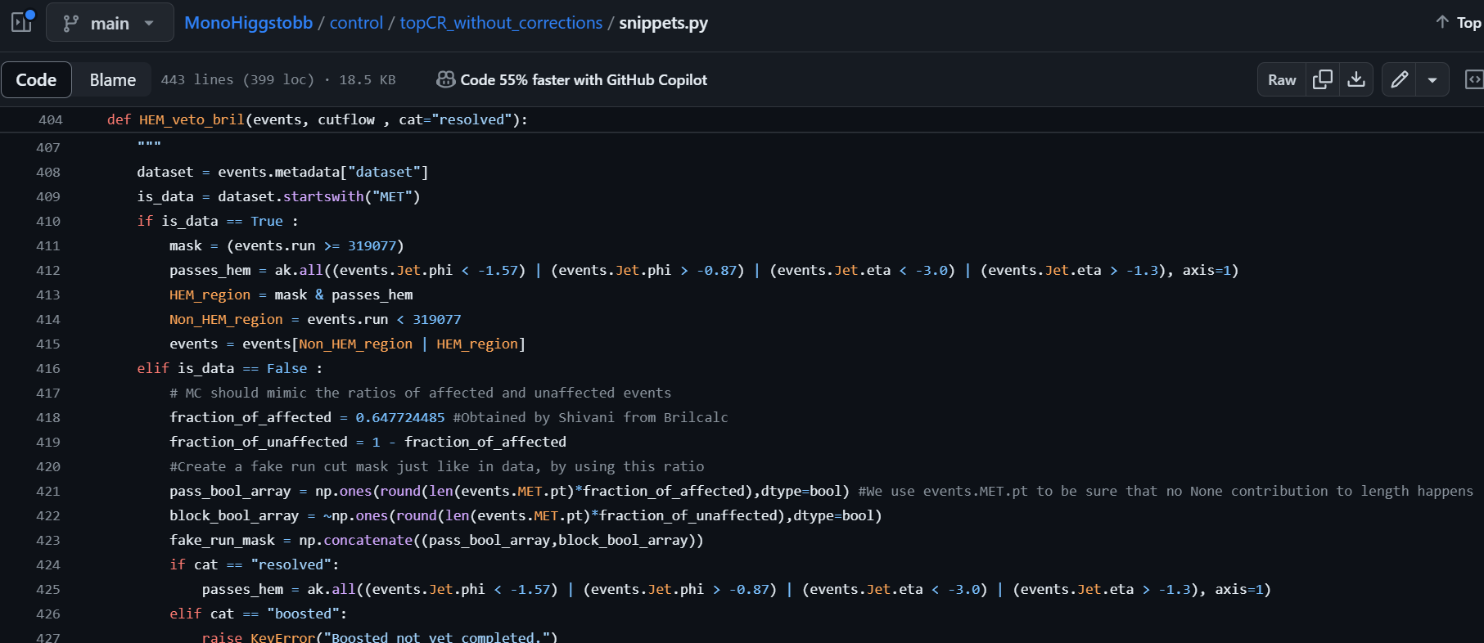
My Efforts
I have performed the Resolved Top Muon CR estimation for 2018.
More than 30,200 lines of code excluding blank lines written to get to the final optimized size of less than 3000 lines.
Almost 22 Terabytes of samples were processed multiple times.
Hours of development and processing in compute farms.

Slide 20

Top $μ$ Resolved jets Top single muon
Plots

Slide 21
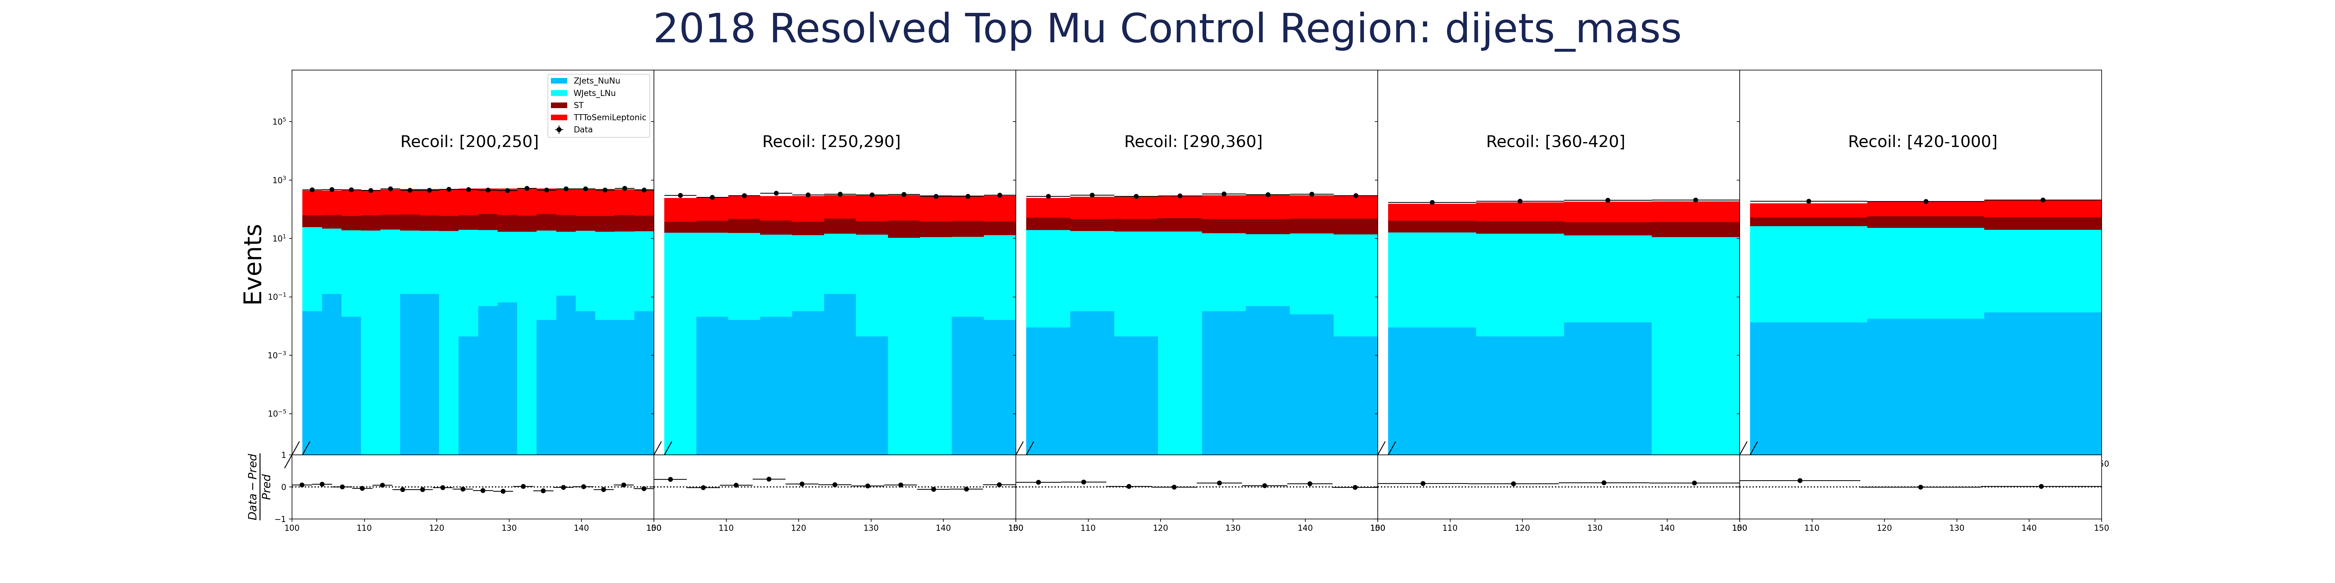
Dijet Mass
Dijet Mass

Slide 22
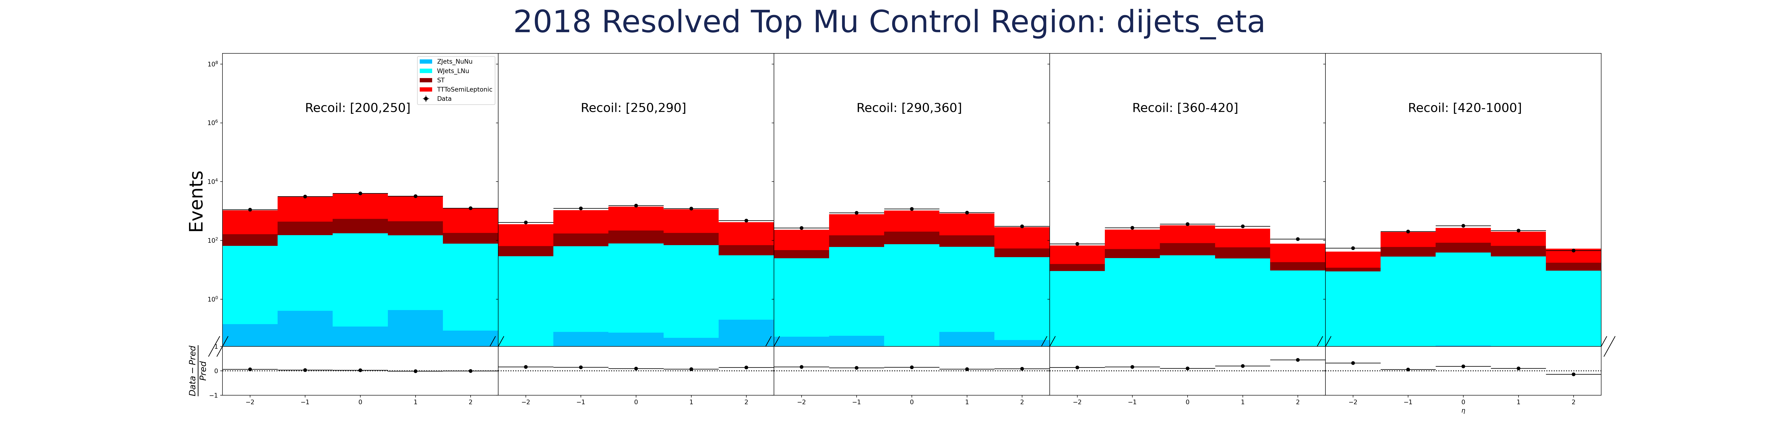

Dijet $η$
Dijet $η$

Slide 23
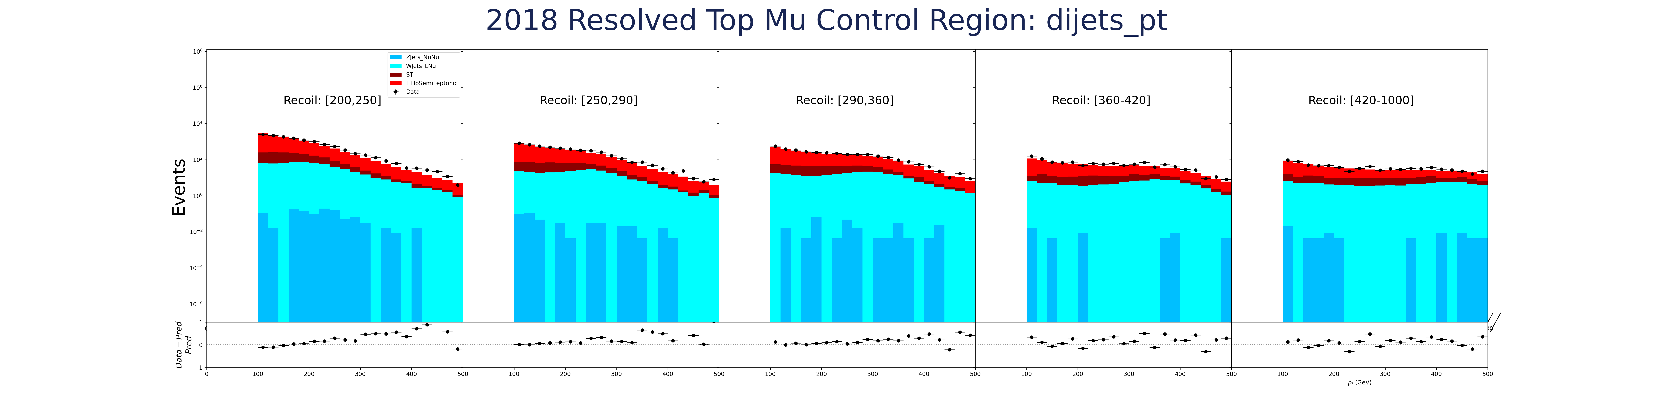
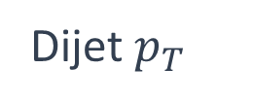
Dijet $p_{T}$
Dijet $p_{T}$

Slide 24
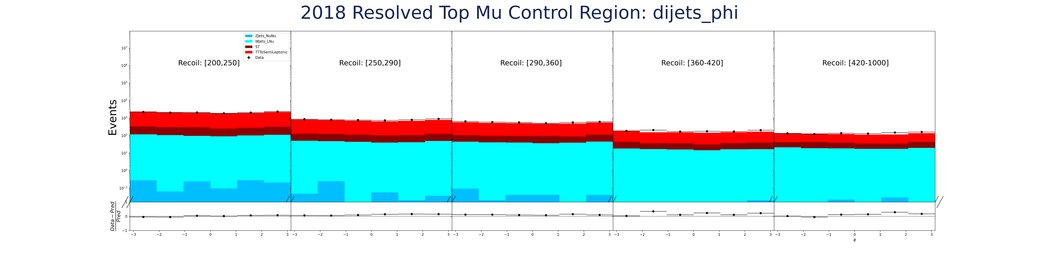

Dijet $φ$
Dijet $φ$

Slide 25



Missing transverse momentum $φ$ (MET-$φ$)
MET $φ$

Slide 26
Future Aspects
Next: do single electron CR estimation so that I can estimate top background in SR using both muon and electron CR.
Notes:
Old future aspects:Perform all or some part of control region studies with all the corrections, scaling, refactoring etc.
Perform signal region studies if time permits.

Slide 27
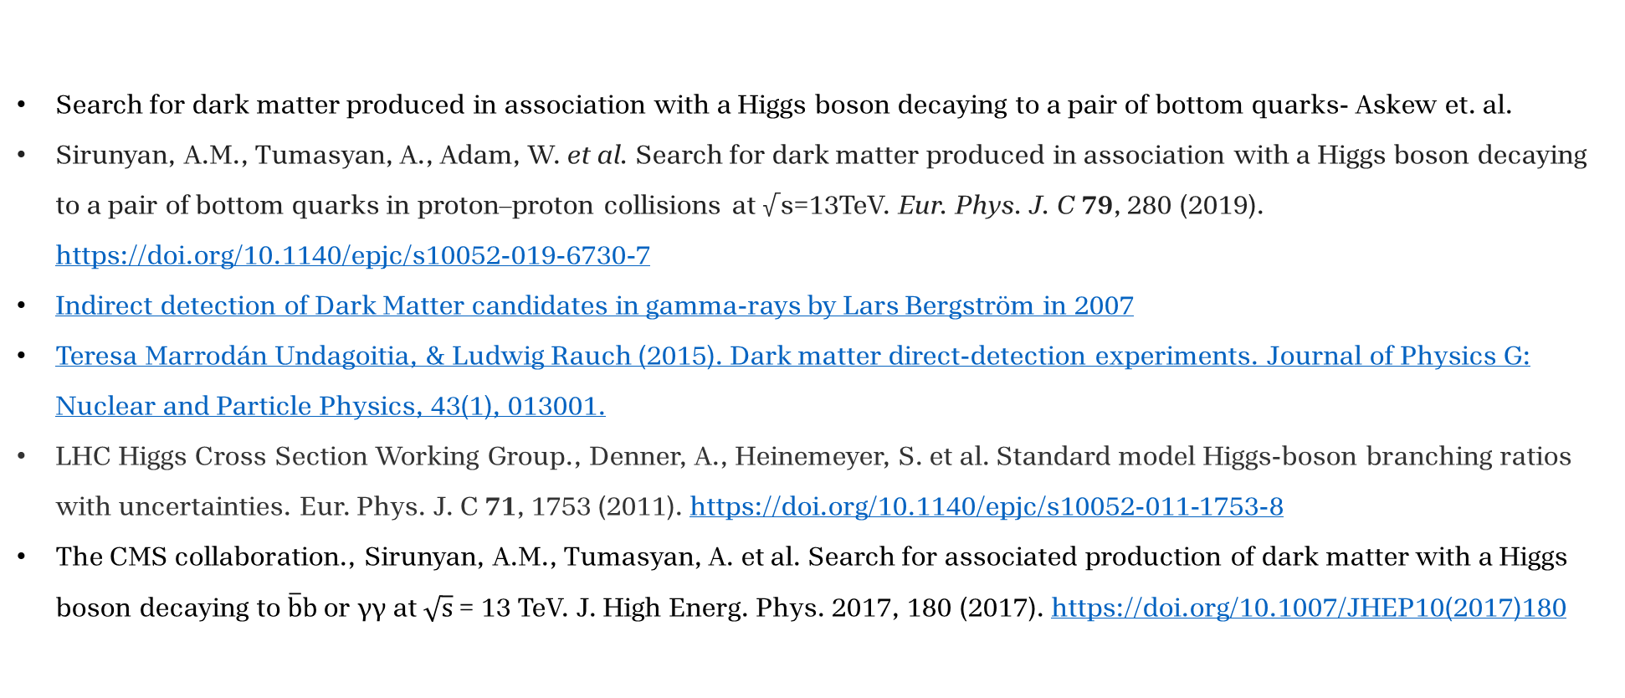
References
Search for dark matter produced in association with a Higgs boson decaying to a pair of bottom quarks- Askew et. al.
Sirunyan, A.M., Tumasyan, A., Adam, W. et al. Search for dark matter produced in association with a Higgs boson decaying to a pair of bottom quarks in proton–proton collisions at √s=13TeV. Eur. Phys. J. C 79, 280 (2019). https://doi.org/10.1140/epjc/s10052-019-6730-7
Indirect detection of Dark Matter candidates in gamma-rays by Lars Bergström in 2007
Teresa Marrodán Undagoitia, & Ludwig Rauch (2015). Dark matter direct-detection experiments. Journal of Physics G: Nuclear and Particle Physics, 43(1), 013001.
LHC Higgs Cross Section Working Group., Denner, A., Heinemeyer, S. et al. Standard model Higgs-boson branching ratios with uncertainties. Eur. Phys. J. C 71, 1753 (2011). https://doi.org/10.1140/epjc/s10052-011-1753-8
The CMS collaboration., Sirunyan, A.M., Tumasyan, A. et al. Search for associated production of dark matter with a Higgs boson decaying to $\overline{b}b$ or γγ at $\sqrt{s}$ = 13 TeV. J. High Energ. Phys. 2017, 180 (2017). https://doi.org/10.1007/JHEP10(2017)180

Slide 28
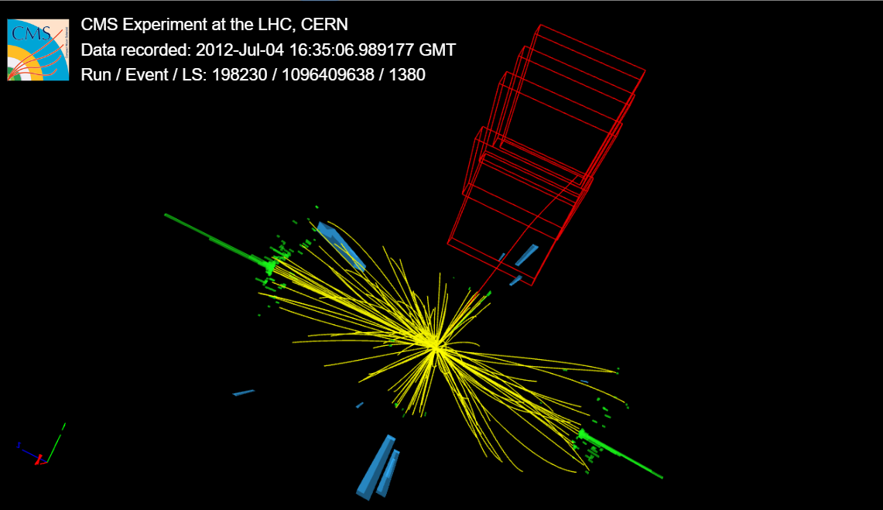
Thank you for your attention.
From iSpyGL , CERN open data

Slide 29
Backup Slides

Slide 30
Quick Recap

Slide 31
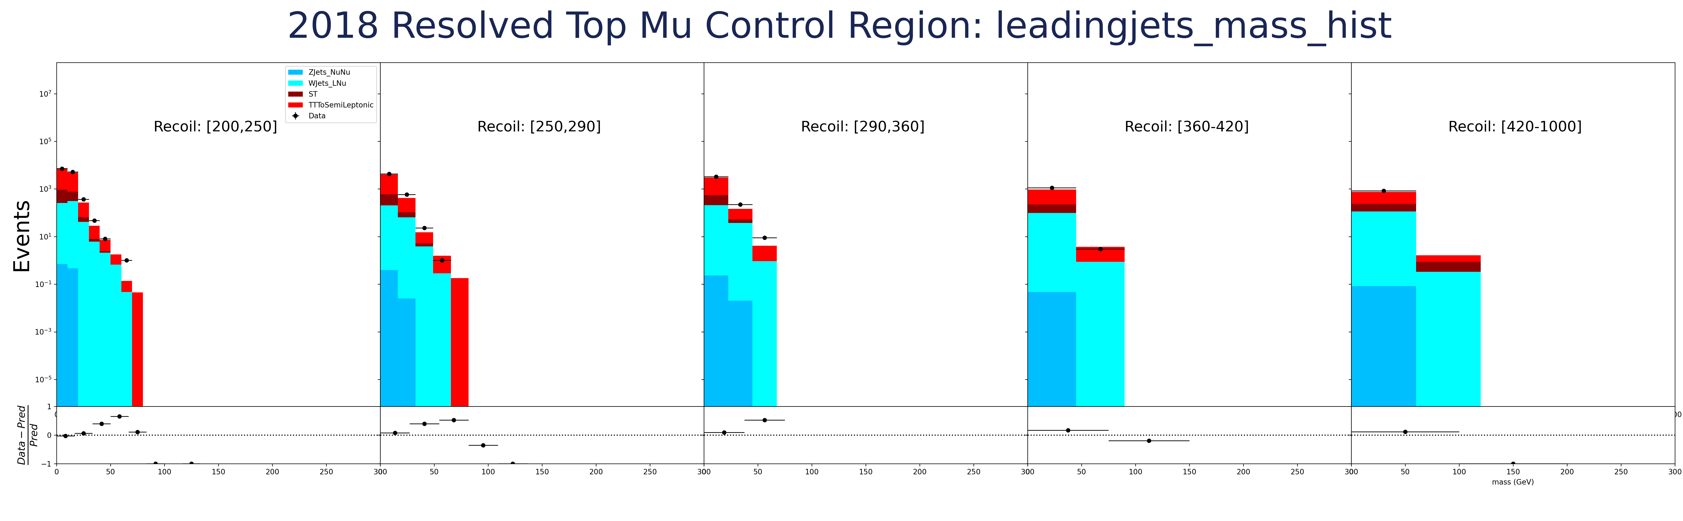
Leading Jet mass

Slide 32
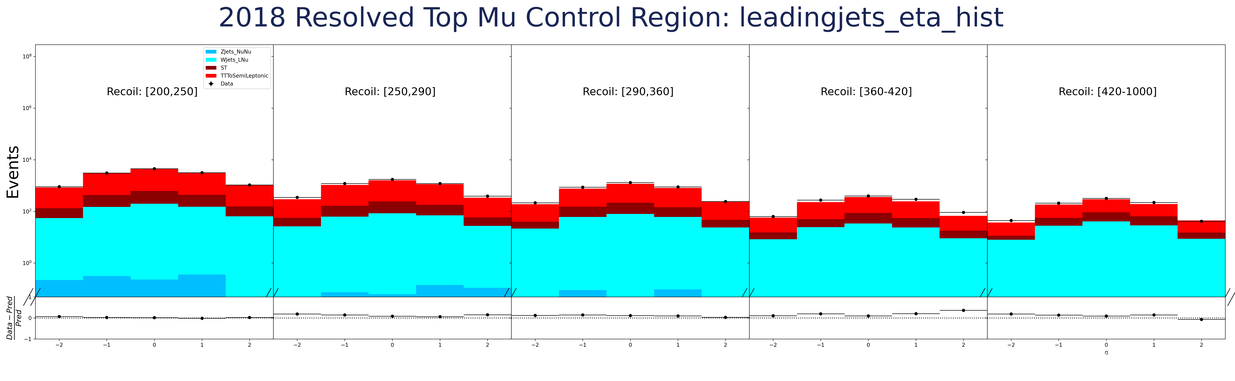
Leading Jet eta

Slide 33

Leading Jet phi

Slide 34
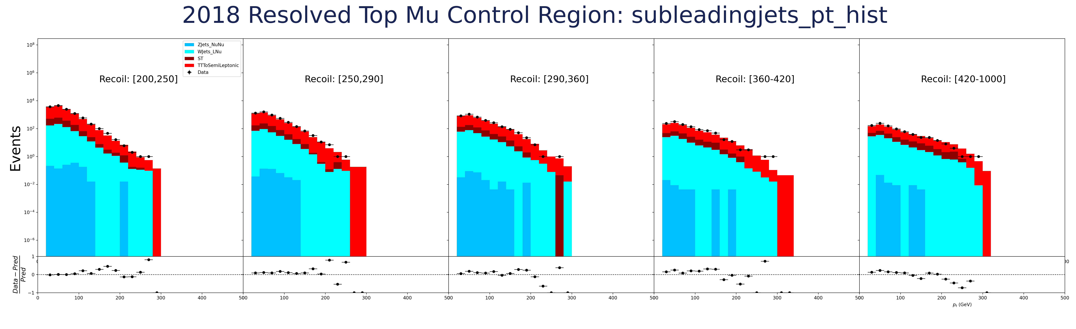
Subleading Jet pt

Slide 35
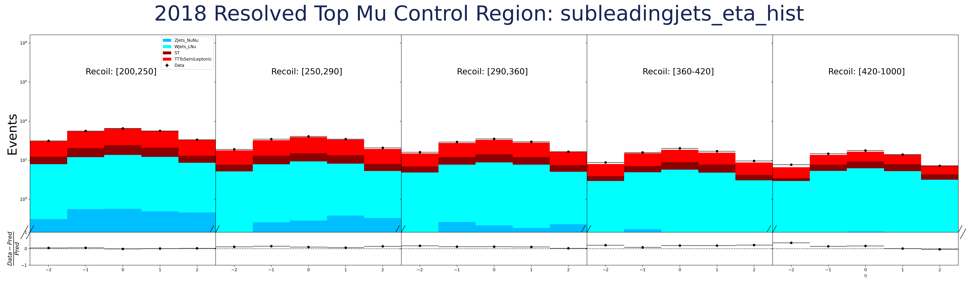
Subleading Jet eta

Slide 36

Subleading Jet phi

Slide 37
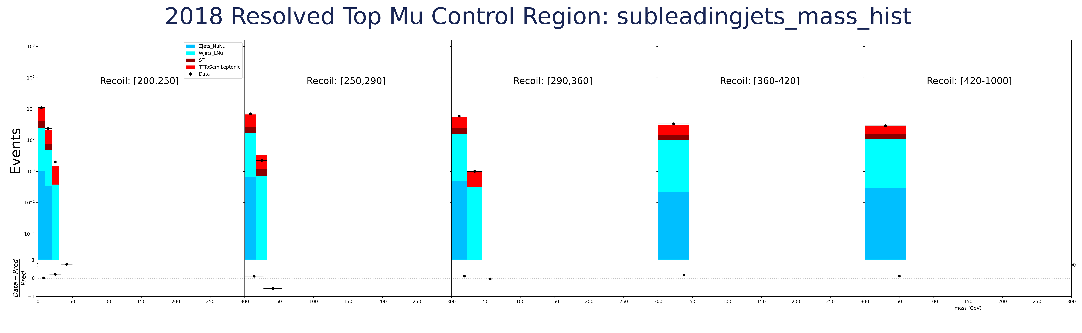
Subleading Jet mass

Slide 38
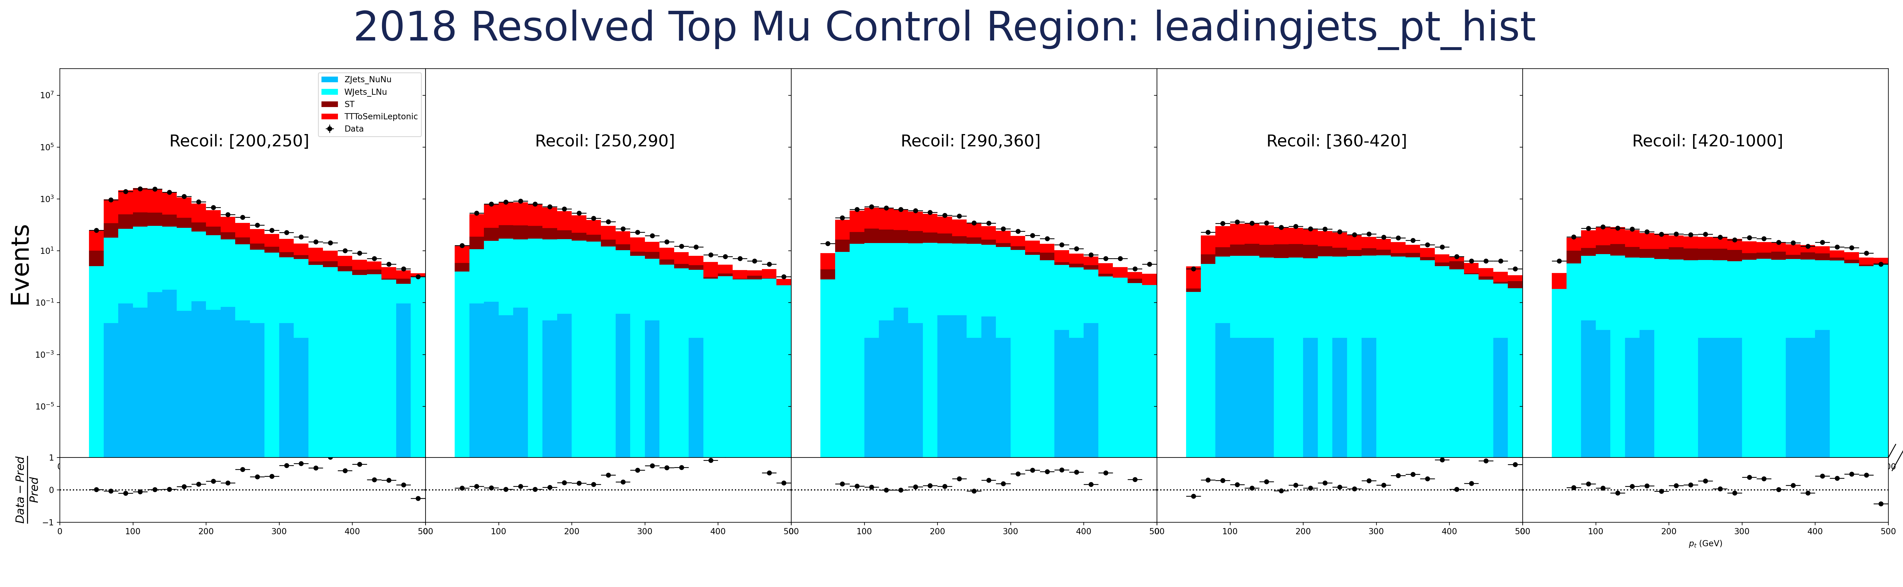
Leading Jet pt

Slide 39
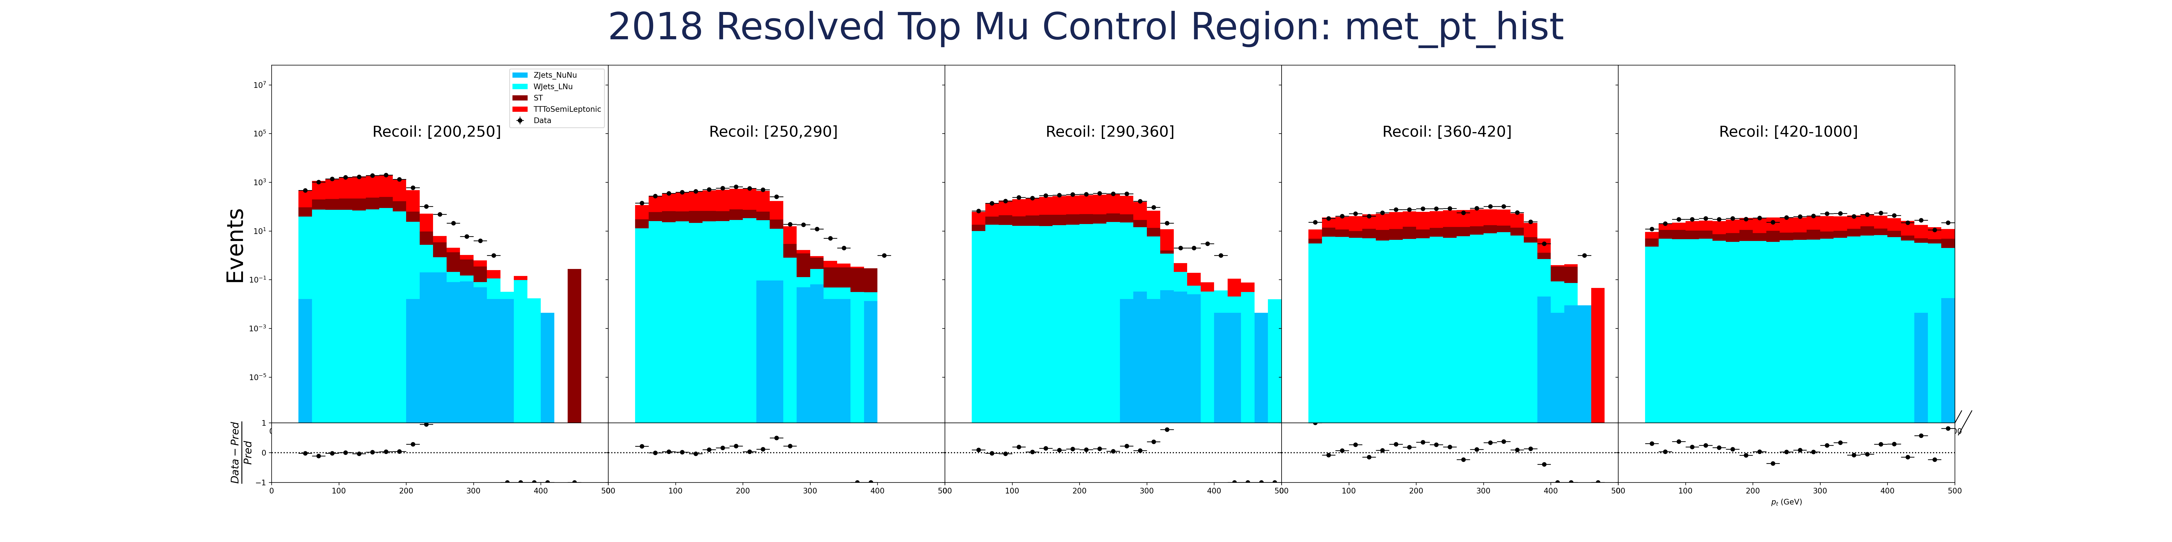

Missing transverse momentum ($p_{T}^{miss}$)
$$p_{T}^{miss}$$

Slide 40
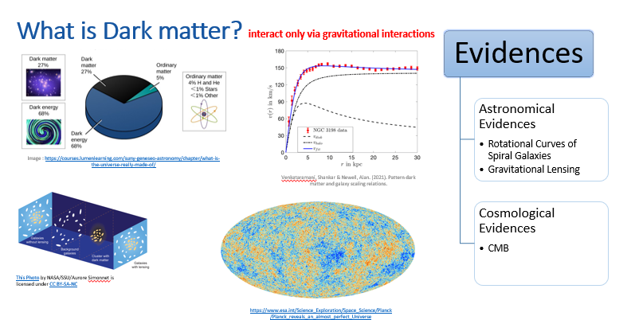
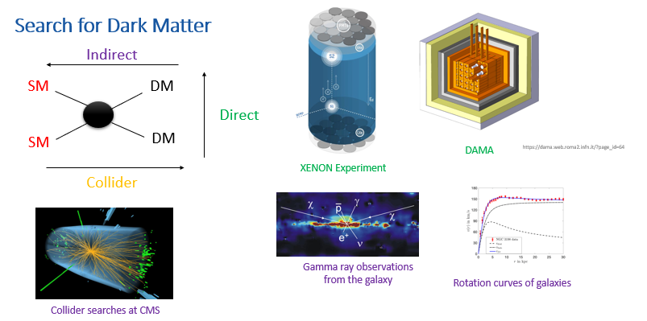
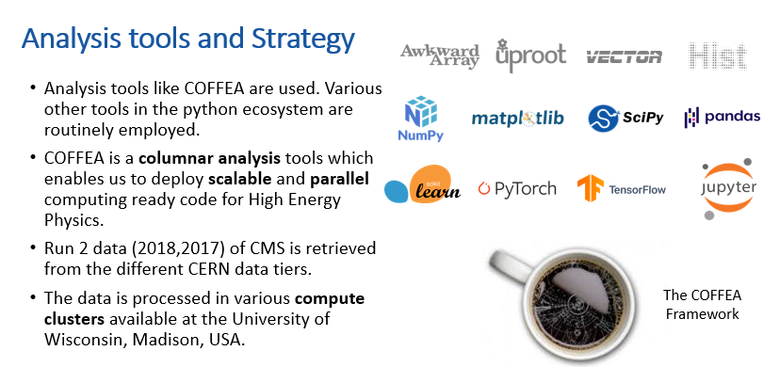
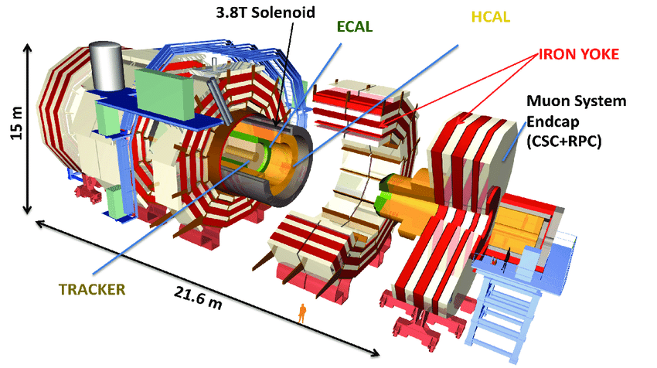
CMS Detector near Geneva
Recap

Slide 41
Analysis tools and Strategy
Analysis tools like COFFEA are used. Various other tools in the python ecosystem are routinely employed.
COFFEA is a columnar analysis tools which enables us to deploy scalable and parallel computing ready code for High Energy Physics.
Run 2 data (2018,2017) of CMS is retrieved from the different CERN data tiers.
The data is processed in various compute clusters available at the University of Wisconsin, Madison, USA.
The COFFEA Framework

Slide 42
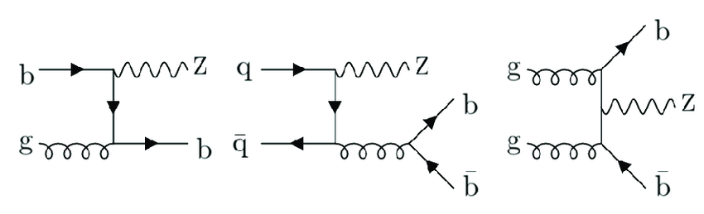

Major Backgrounds: Z+jets Control Region
The Z+jets is the second major background to the final state.
This background too is estimated by defining a control region which is designed to tag such a background.
the Z further decays
$$Z→νν$$
https://www.researchgate.net/figure/Examples-of-Feynman-diagrams-for-Z-1-b-jet-left-and-Z-2-b-jets-middle-and-right_fig1_357171275

Slide 43
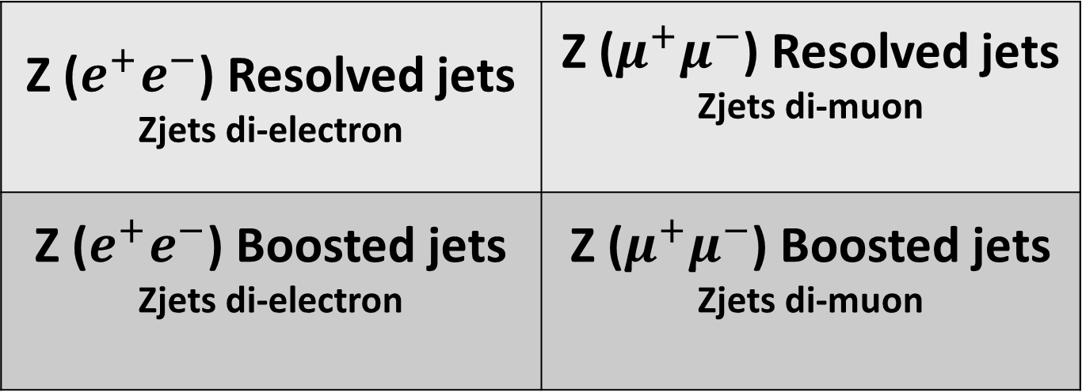
Major Backgrounds: Zjets Control Region
This control is called the Zjets Control region and is further subdivided into four categories.
Z ($e^{+}e^{−}$) Resolved jets Zjets di-electron | Z ($μ^{+}μ^{−}$) Resolved jets Zjets di-muon
Z ($e^{+}e^{−}$) Boosted jets Zjets di-electron | Z ($μ^{+}μ^{−}$) Boosted jets Zjets di-muon
Jet angular separation
Lepton variety
Notes:
Questions:
Why is there no tau CR?
Check in the 2016 paper

Slide 44
Avoiding Detection issues
Recommended filters to remove detector noise and imperfections
MET Filters
HEM Veto
Flag.goodVertices
Flag.globalTightHalo2016Filter
Flag.globalSuperTightHalo2016Filter
Flag.HBHENoiseFilter
Flag.HBHENoiseIsoFilter
Flag.eeBadScFilter
Flag.EcalDeadCellTriggerPrimitiveFilter
Flag.BadPFMuonFilter
Flag.BadPFMuonDzFilter
Flag.ecalBadCalibFilter

Slide 45
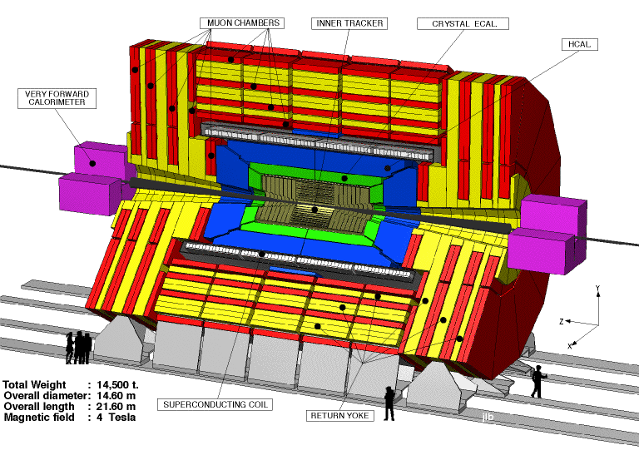
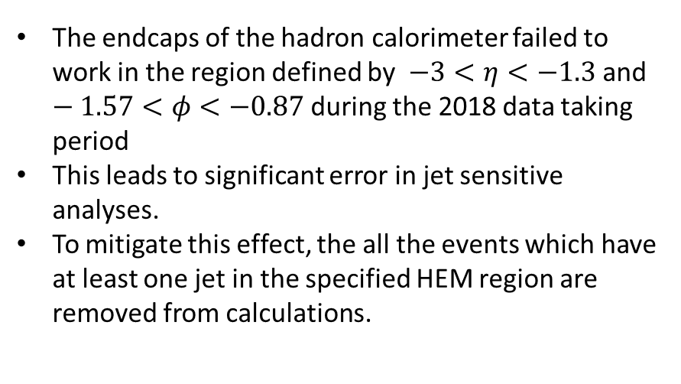
Avoiding Detection issues
Hadronic Calorimeter Endcaps minus (HEM) issue
MET Filters
HEM Veto
The endcaps of the hadron calorimeter failed to work in the region defined by $−3<η<−1.3$and $−1.57<φ<−0.87$ during the 2018 data taking period
This leads to significant error in jet sensitive analyses.
To mitigate this effect, the all the events which have at least one jet in the specified HEM region are removed from calculations.
http://www.phys.ufl.edu/hee/cms/cms.html

Slide 46
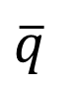

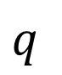



Collider Search: Mono-X Topology
DM
$p_{T}^{miss}$
Back to undetectable dark matter production
DM
(Measurable)
DM
X
(SM particle)
DM
$p_{T}^{miss}$
DM
$$q$$
DM
$$q$$
DM
$$\overline{q}$$
$$\overline{q}$$
DM
X

Slide 47



Mono Higgs Searches
No Initial State Radiation
More closely connected to DM production
Signal Signature has a high MET trail which helps to separate the signal from background.
$p_{T}^{miss}$
$$χ$$
$$q$$
$$\overline{χ}$$
H(125)->bb branching ratio is ~ 57%
$$\overline{q}$$
$$\overline{b}$$
h
$$b$$

Slide 48



Other backgrounds (continued)
Diboson VV
Drell-Yan+Jets
SM-Higgs

Slide 49


Other backgrounds
W+Jets
Single Top

Slide 50

Triggers
Triggers are fast data acquisition selectors.
A trigger ‘turns on’ when a group of physics components are satisfied for a proton-proton collision event.
For this analysis, we use a High-Level Trigger which is triggered when energies of all the reconstructed MET in an event don’t have a muon contribution in them.
This is done to avoid situations in which we have a muon contribution in MET which we want to probe independently of the MET.
HLT.PFMETNoMu120_PFMHTNoMu120_IDTight
https://cds.cern.ch/record/2712881

Slide 51




The 2HDMa Model
$$\overline{b}$$
A supersymmetric model to explain dark matter
$$b$$
The 2HDM Model proposes five Higgs :
Two neutral scalars ($h$ and $H$)
Pseudoscalar $A$ and
Charged Higgs($H^{−}$ and $H^{+}$.)
The 2HDMa model introduces a new pseudoscalar ‘a’ which mediates interaction between Dark particles $χ$and $\overline{χ}$ .
The Higgs SM ‘h’ produced can decay through many channels.
One of these channels is the Higgs to two b-quarks.
These b quarks produce jets of particles.
The Dark matter particles go undetected and lead to a large missing momentum.
2HDM = Two Higgs Doublet Model
2HDMa = Two Higgs Doublet Model with a pseudoscalar mediator ‘a’
Final state: $H(\overline{b}b)+p_{T}^{miss}$
Notes:
Paste the definition of ptmiss

Slide 52



The Coordinate System
The Interaction point(IP) is the origin of the coordinate system.
X direction points to the centre of the LHC ring
Y direction points vertically upwards.
Z direction points towards the western side of beam axis.
The positive angle from the x axis is the azimuthal angle φ .
The positive angle from the z axis is the polar angle θ.
Pseudorapidity is defined as:
https://tikz.net/axis3d_cms/

Slide 53
Additional jets
In signal region we allow less than or equal to 2 additional jets other than those required to create the dijet object.
The topology of the backgrounds show that they tend to have at least one additional jet.
For this reason we enforce at least one additional jet in the control Region.
Additional Jets

Slide 54




The Coordinate System
https://tikz.net/axis3d_cms/

Slide 55
Fig : Schematic Representation of the CMS detector
Focardi, Ettore. (2012). Status of the CMS Detector. Physics Procedia. 37. 119-127. 10.1016/j.phpro.2012.02.363.

Slide 56

Hadronic Calorimeter
It consist of hadron calorimeter barrel and hadron end caps which are located outside the ECAL.
The hadron calorimeter barrel is located outside extent of ECAL (R=1.77m) and inner extent of magnetic coil(R=2.95m)
The outer hadron calorimeter or tail catcher is placed outside the solenoid contemplating barrel calorimeter. Beyond |η| = 3, the forward calorimeter (HF)is placed at 11.2m from interaction point and a psuedorapidity up to |η|=5.2
Chatrchyan, S. & Nedelec, Patrick & Sillou, Daniel & Besancon, M. & Chipaux, Remi & Dejardin, M. & Denegri, D. & Descamps, J. & Fabbro, B. & Faure, J.L. & Ferri, Frederick & Ganjour, S. & Gentit, F & Givernaud, A. & Gras, Philippe & Monchenault, G & Jarry, P & Lemaire, M & Locci, E. & Romaniuk, Ryszard. (2010). Performance of the CMS Hadron Calorimeter with Cosmic Ray Muons and LHC Beam Data. Journal of Instrumentation. 5. T03012.

Slide 57
Hadronic Calorimeter
HB consist of 36 azimuthal identical wedges covering a psuedorapidity of |η|<3 and each wedge is divided into 16 azimuthal plates, fitted in such a way that there is no projective dead material
The first and last layer is made up of stainless steel for stability and all other layers are made in brass.
The end cap sector covers 1.3 < |η|< 3.0 and uses wavelength shifting fibers as an active medium
These light is then analyzed by hybrid photo diodes(HPDs).

Slide 58
The Trigger System and Data Acquisition

Slide 59

LHC produces a large interaction rates (Bunch crossing rate: 40 MHz)
Each recorded event has a size around 1 MB; This makes it impossible to store all the data from the pp collisions at the designed bunch crossing rate.
The Trigger system, is designed to select the best events from the collisions in real time.
The Trigger Systems consists of : Level 1 trigger (L1 Trigger) and High Level Trigger(HLT).

Slide 60

L1 Trigger
The Level 1 trigger is a hardware based processing system which employs the use of programmable electronics like FPGAs extensively.
The L1 trigger reduces the input crossing rate of 40MHz to an output rate of 100KHz.
The L1 trigger follows a hierarchy as shown in the figure. The Global Trigger takes input from two , subsystems: Calorimeter trigger and Muon trigger system.
The raw data from detector elements first reaches the “trigger primitives”. These are represented in the top of the diagram.
The regional detectors combine the information from trigger primitives to create ranked objects. For example, an e/γ candidate has deposits energy in narrow η . The RCT identifies and sorts such objects.

Slide 61

L1 Trigger
The Global Calorimeter and Global Muon Trigger, sort the trigger objects from Regional Triggers into a ranking and feed to the Global Trigger.
The Global Trigger takes the topology of the detector and other factors into consideration. It takes into account, various physics criteria to make a decision to keep an event or not.

Slide 62

High Level Trigger
HLT is a software based processing system which employs commercial microprocessor based farms for trigger. The trigger farm is composed of about 2000 PCs.
HLT takes information from L1 at 100 kHz and makes selections to produce a final rate of about 800Hz.
HLT is much slower than L1 and has to account for possible failures of computing nodes.
HLT builds one full event from the event fragments it gets as input.
HLT is also responsible for Jet Reconstruction.
An HLT rack

Slide 63
References
1.V. Khachatryan, et al. "The CMS trigger system". Journal of Instrumentation 12. 01(2017): P01020–P01020.
2. Collaboration, SMS & Warsaw, CMS & Pozniak, Krzysztof & Romaniuk, Ryszard & Zabolotny, Wojciech. (2010). Commissioning of CMS HLT. Journal of Instrumentation. 5. T03005. 10.1088/1748-0221/5/03/T03005.
3. Brooke, James & Cussans, David & Frazier, Ricky & Heath, G & Machin, D & Newbold, D & Galagadera, S & Madani, Sadaf & Shah, Abid. (2023). Hardware and Firmware for the CMS Global Calorimeter Trigger.
4. Manfred Jeitler on https://cms.cern/news/real-time-analysis-cms-level-1-trigger
5. Nil Valls on http://www.nilvalls.com/compact-muon-solenoid-up-close-and-personal/
6. Search of Large Extra Dimensions in final state in pp collisions with the CMS Detector at the LHC, Dr. Bhawna Gomber

